Slide 1
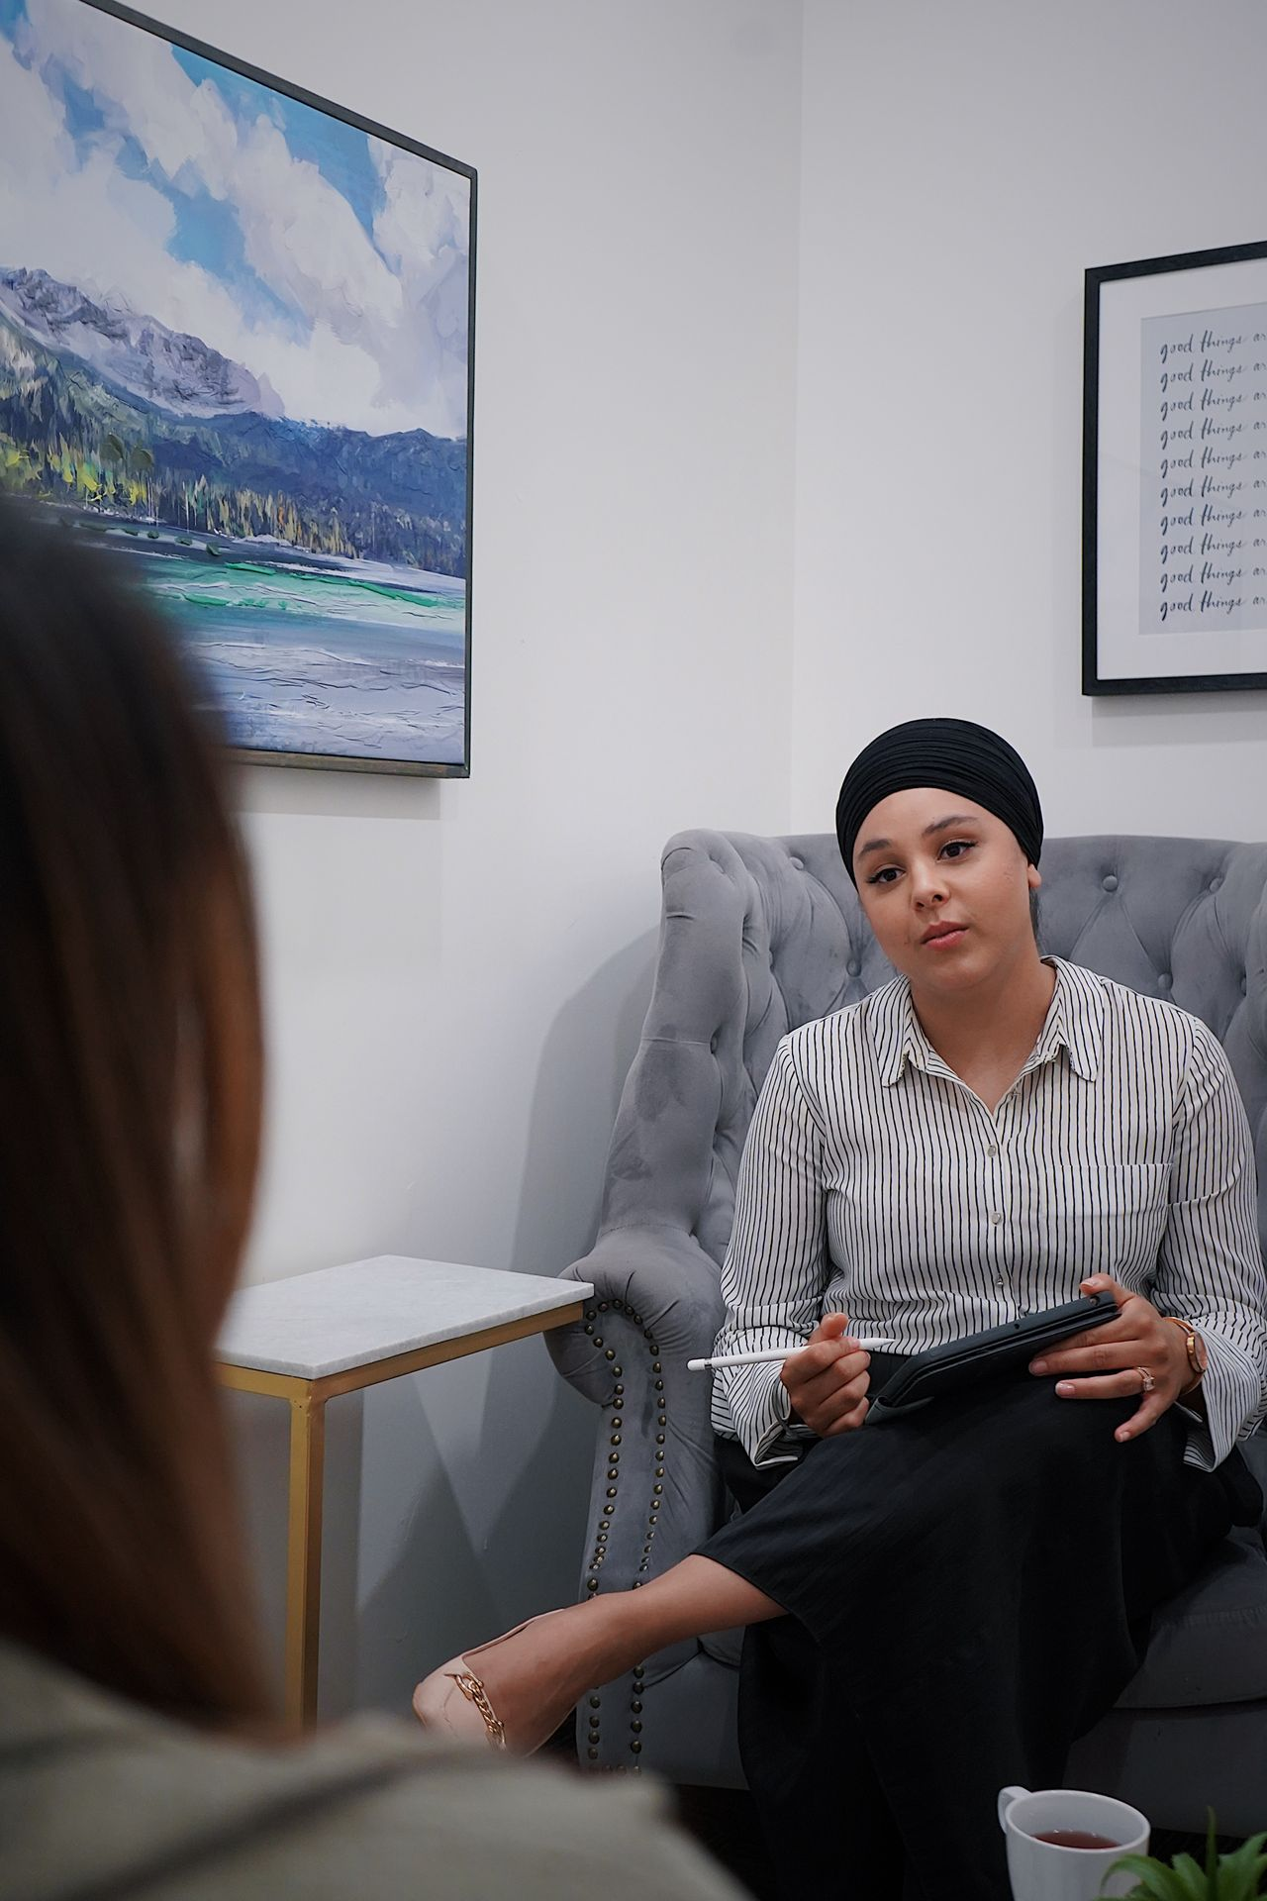
Depression: What
to Know
Grades 7–9
Together For Health

Slide 2
1 in 8
adolescents in Canada experience depression
It is one of the most common mental health conditions among teens. You are far from alone.
Together For Health

Slide 3
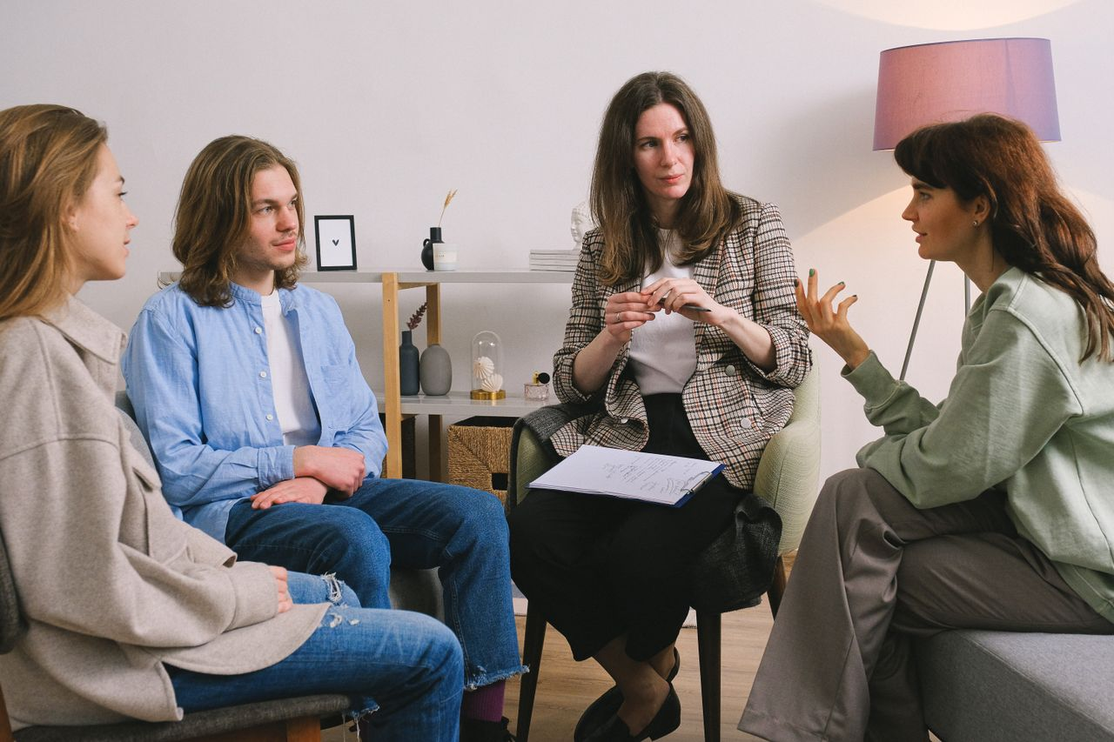
🔍
Depression vs. Normal Sadness
Sadness: short-lived, tied to an event, fades with time
Depression: lasts 2+ weeks, not always tied to an event
Depression affects sleep, appetite, concentration, and energy
Depression can cause physical symptoms — headaches, stomach aches
You can have depression even if life looks "fine" from the outside
Together For Health

Slide 4
⚠️
Risk Factors — What Increases the Chances
Family history of depression
Trauma or significant loss
Chronic stress or bullying
Low self-esteem
Substance use
Together For Health

Slide 5

💬
How to Talk to a Friend Who Might Be Depressed
Find a private, comfortable moment
1
Say: "I have noticed you seem down lately. Are you okay?"
2
Listen — do not try to fix it immediately
3
Avoid saying "just cheer up" or "you have so much to be happy about"
4
Ask: "Can I help you talk to someone?"
5
Stay in their life — keep reaching out even if they pull away
6
Together For Health

Slide 6
💊
Treatment Works
80% of people with depression improve with treatment.
Therapy (especially CBT) and medication can be very effective. Do not wait.
Together For Health

Slide 7
KEY TAKEAWAYS
Depression is treatable — with the right support, people recover
✓
Early help leads to faster and fuller recovery
✓
Your mental health matters as much as your physical health
✓
Resources
Kids Help Phone: 1-800-668-6868
Text HOME to 686868
Talk to your school counsellor or doctor
Together For Health

